Slide 1
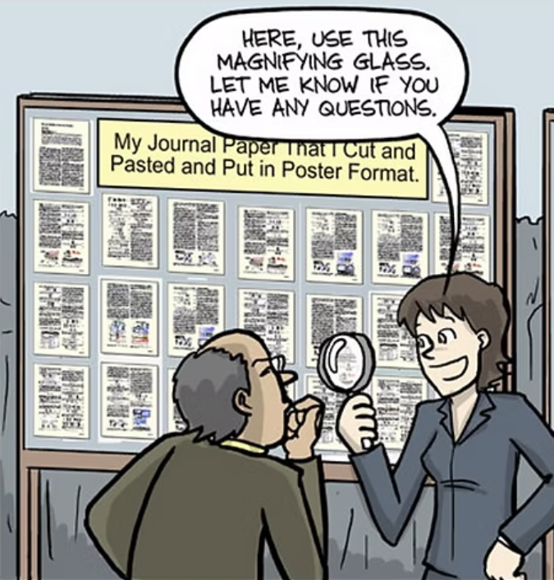
Poster Tips

Slide 2
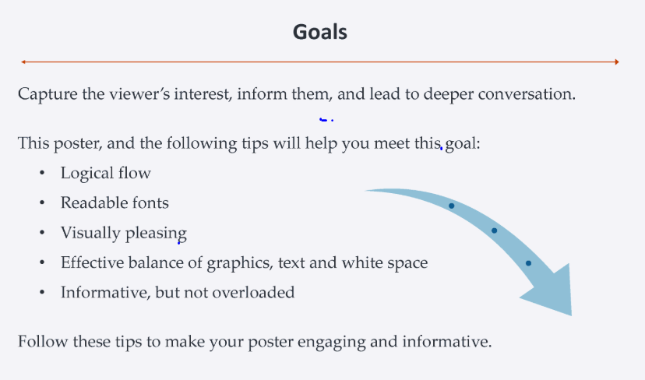

Slide 3
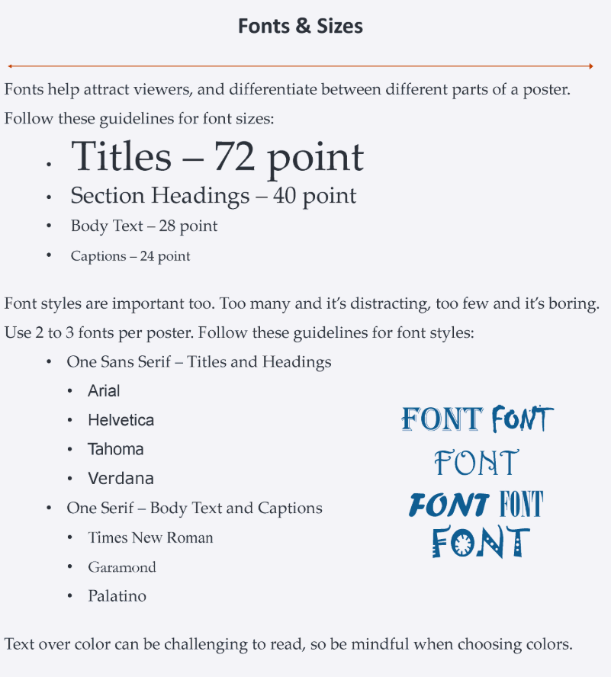
Title should be concise & elicit interest.
Include authors plus affiliations (i.e., department/program)
Keep fonts and themes (e.g. colors, designs) somewhat consistent.

Slide 4
Pointers
Bullet points or separated paragraphs
60% graphics, 40% text
Use the poster template because it has the right dpi and dimensions, but modify as you wish.
Ideally, insert objects instead of copying and pasting them.

Slide 5
What does a poster include?
See Template – This can be downloaded at the Cascades Undergraduate Research Symposium website (link below). Please use this template to prepare your poster or it may not fit properly for printing.
OSU-Cascades Undergraduate Research Symposium website
https://osucascades.edu/research/students/cascades-research-and-scholarship-symposium

Slide 6
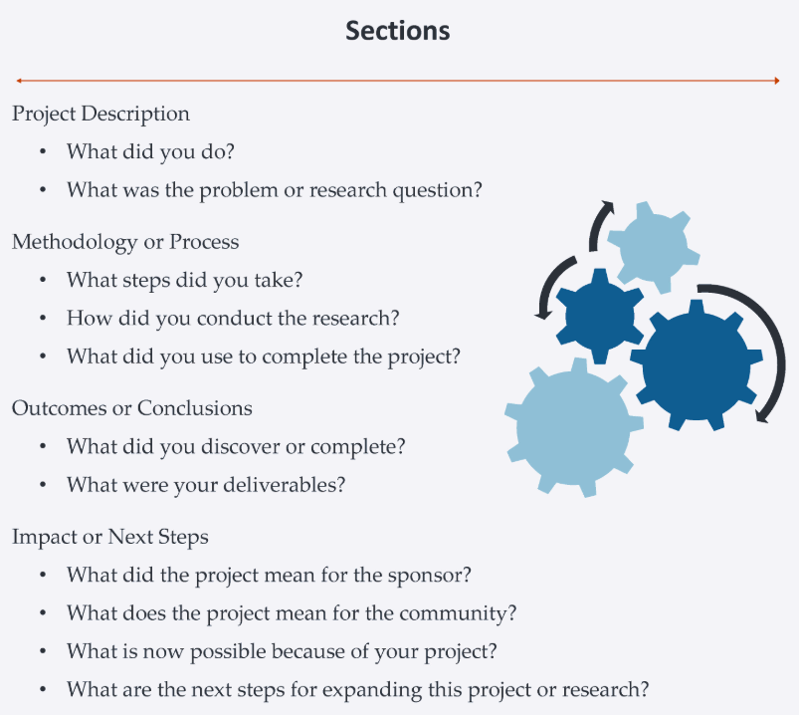

Slide 7
Don’t forget citatons & acknowledgments!
Posters generally do not have to be too heavy on citations. Make sure all your citations are uniformly cited.
Examples of acknowledgments:
Sponsors – URSA, OSU-Cascades Undergraduate Fellowship, etc.
Any mentors not already listed as coauthors
Helpers/collaborators
Property owners or study site facilitators

Slide 8
Breakout Discussion - What makes a good poster?
Title is concise and draws interest from the audience.
Text is clear and big enough to read from a distance.
Bullet points and numbering make content easy to understand.
Theme should be consistent and pleasing to look at.
Not too texty.
Discuss these examples
Did anyone bring a poster for review?
Posters from previous years can be accessed here:
https://oregonstate.box.com/s/733350f6vh0plkjpssybl58upm1741mb
Other examples at the OSU library web page (scroll down for the examples) -
https://undergradresearch.oregonstate.edu/how-make-poster

